Slide 1
MIKE 11
Hydrological Modelling – Rainfall Runoff Module (RR)

Slide 2
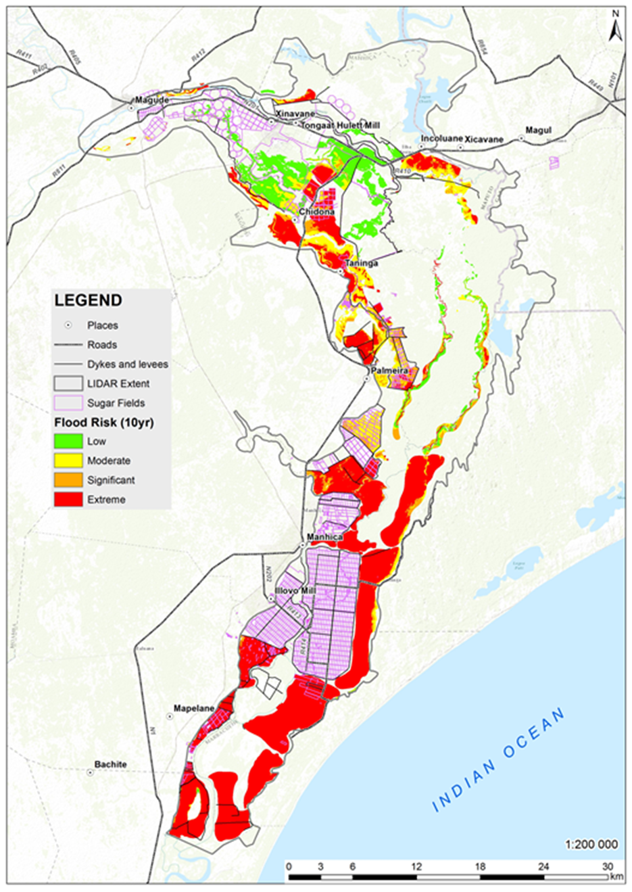
Key concepts in Flood Risk Management
Flood Hazard: Potentially damaging flood event causing loss of life or injury, property damage, socio-economic disruption, loss of livelihood or environmental degradation, among others
Vulnerability: A set of physical, social, economic and environmental factors that defines the susceptibility of a community to the impact of floods
Flood Risk: The probability of harmful consequences resulting from the interaction between flood hazards and vulnerability of people and property
Flood Mitigation: Short and long term actions, programmes or policies reducing the flood risk

Slide 3

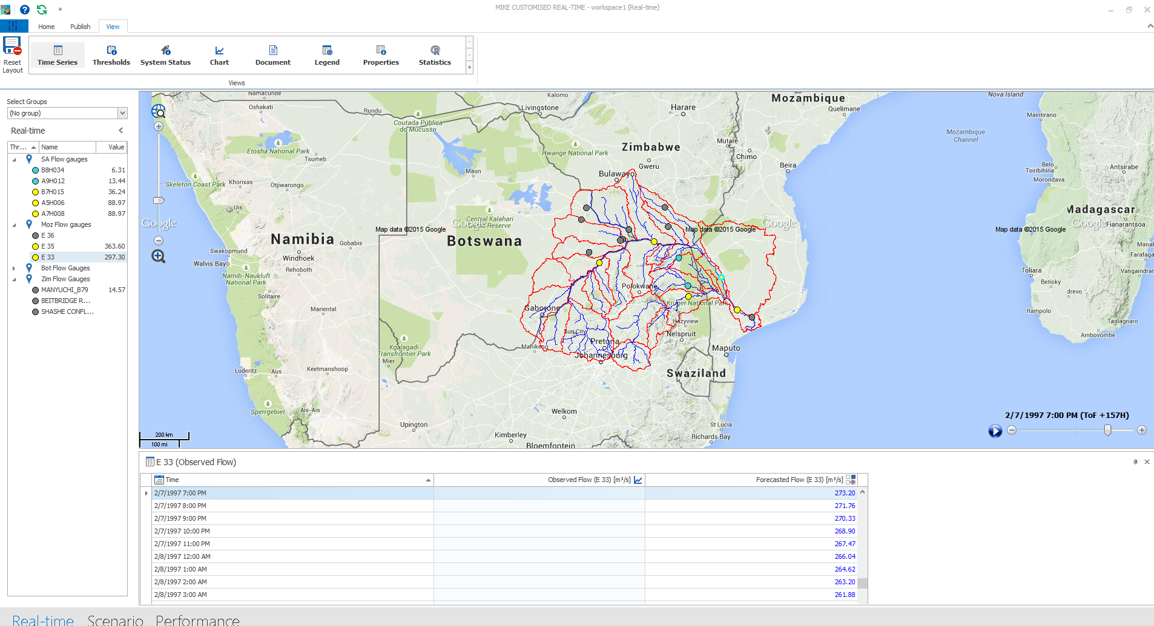
EWFF System Architecture
Decision Support System
Real Time Operation Centre
Early Warning Unit
Real Time Data
Toolbox
Satellite
Hydraulic model
Radar
Measurement
Customised Platform
Forecast information
Early Warning
Appropriate Response
National, Provincial and Municipal Operational Coordination Committee
Public Web
Police
Disaster Management
Fire Department
Civilians
Civil Defence
Hospitals

Slide 4
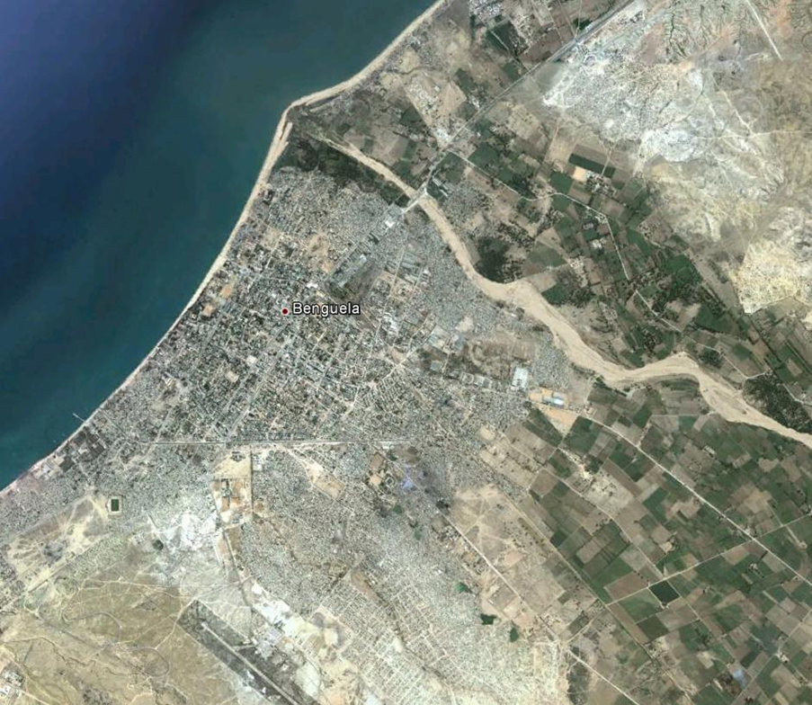
Lead time and Accuracy of prediction
Use Weather
Forecasts
Use actual recorded rainfall
Using Measured flow data
Extended Warning
Lead time 10 – 14 days
Extended Warning
Lead time 3 – 4 days
Extended Warning
Lead time 1 – 2 days
Tradeoff
Lead time
Vs
Accuracy
Forecast
Rain
Rain Runoff
Hydraulic
Actual
Rain
Rain Runoff
Hydraulic
Rec Runoff
Hydraulic
© DHI
2 September, 2019
#4

Slide 5
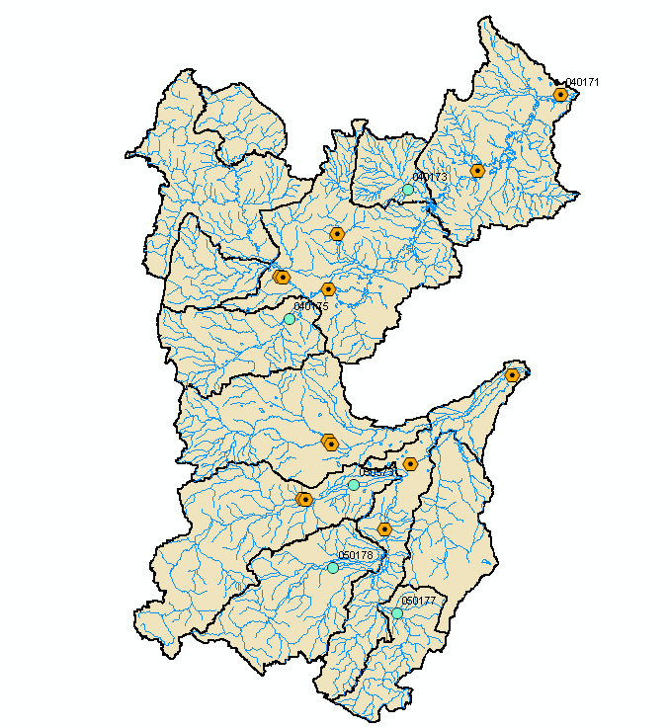
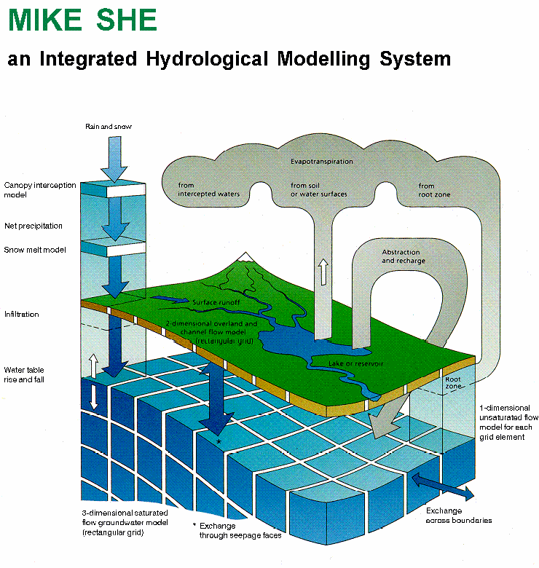
HYDROLOGICAL MODELLING
The NAM Conceptual model

Slide 6
HYDROLOGICAL MODELLING
River Basin Models - Terminology
Deterministic: Same Input => Same Output
Stochastic: Same Input => Different output
Empirical Models Quick and simple to apply, when established
Applicability difficult to assess.
(Black Box) Assumes no change in regime
No impact assessment
Conceptual models (lumped or distributed)
Mix of Empirical and physical formulae
(Grey Box) Can solve many water resources problems
Simple impact assessments
Cost effective
Physically Based Distributed Models
Solves the Physical Equations
(White Box) Measurable parameters
Impact assessments

Slide 7
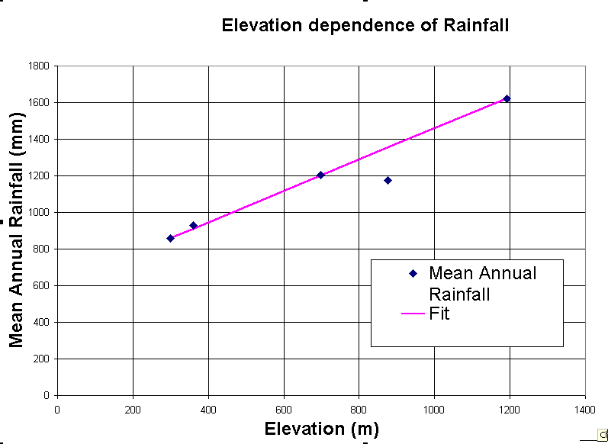
HYDROLOGICAL MODELLING
Empirical Models
Empirical Models Quick and simple to apply, when established
Applicability difficult to assess.
(Black Box) Assumes no change in regime
No impact assessment
Correlation Analysis

Slide 8
HYDROLOGICAL MODELLING
Empirical Models
Typical Examples:
  Various Correlation Methods (station to station, rainfall to discharge)
  Neurological networks
  Rule of thumb
Typical Applications:
  Completion of existing time series
  Forecasting
Other Characteristics:
  Quick and simple to apply (once established)
  Assumes no change in regime
  Applicability on other areas difficult to assess
  No impact assessment

Slide 9
HYDROLOGICAL MODELLING
River Basin Models - Terminology
Conceptual models (lumped or distributed)
Mix of Empirical and physical formulae
(Grey Box) Can solve many water resources problems
Simple impact assessments
Cost effective

Slide 10
HYDROLOGICAL MODELLING
Conceptual Lumped Model
RAINFALL
POTENTIAL EVAPORATION
MODEL
PARAMETERS
RUNOFF COMPONENTS
EVAPORATION
RECHARGE

Slide 11
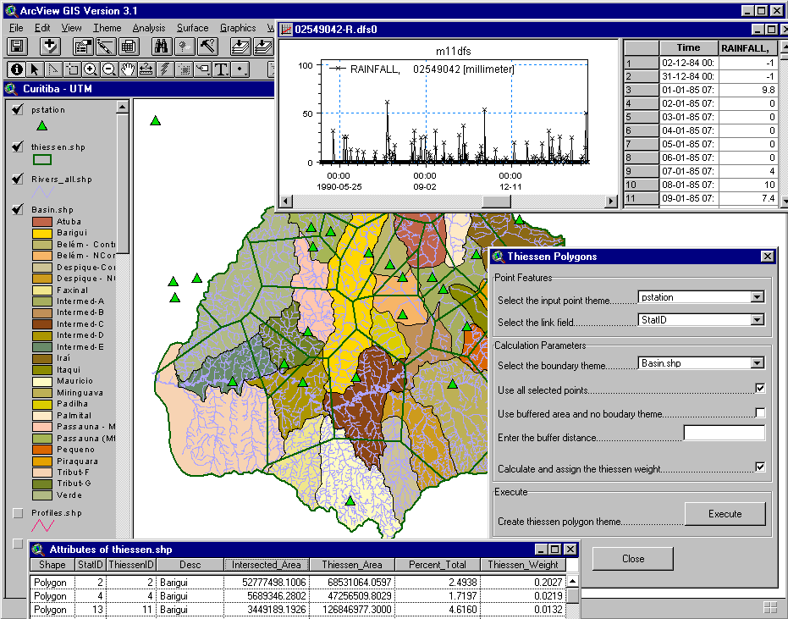
HYDROLOGICAL MODELLING
Conceptual Lumped Model
Consists of:
simplified descriptions of dominating processes
empirical elements
Input and results
from these models represent spatial averages for each model area

Slide 12
HYDROLOGICAL MODELLING
Conceptual Lumped Model
Typical Applications:
  Completion of existing time series
  Run-off from ungauged areas
  Forecasting
  Filtering climatic from man-made trends
  Climatic trends
  Effects of certain man made changes
  Simple Groundwater analyses
  Water balances
Other Characteristics:
  Robust and effective calculations
  Easy to calibrate (with a bit of exercise)
  Can simulate changes in climatic regime

Slide 13
HYDROLOGICAL MODELLING
Deterministic River Basin Models
Physically Based Distributed Models
Solves the Physical Equations
(White Box) Measurable parameters
Impact assessments

Slide 14
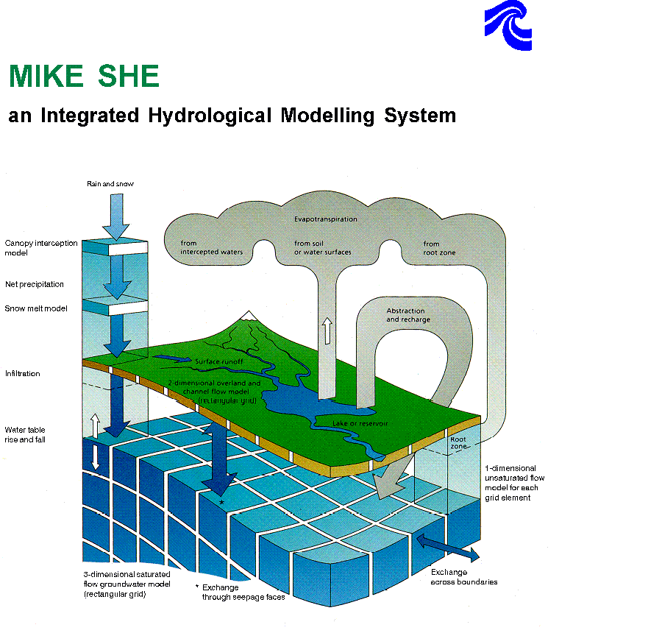
HYDROLOGICAL MODELLING
Process understanding
Confirm or reject theories
Water quality and pollution estimates
Impacts from land use and exploitation
Physically based Distributed Models
Abstraction
UZ
Drains
OL
SZ
River
SZ
SZ
When screening methods or simpler models have indicated a need for further analyses

Slide 15
HYDROLOGICAL MODELLING
Physically based Distributed Models
If you need to study the processes inside the catchment
  Effects of land use change
  Hydraulic effects of structures
  Change in local ground water levels from pumping
  Contamination forecasts and remediation
  Advanced Surface water groundwater interaction
  Drainage and Flood Control
  Advanced Water Quality

Slide 16
HYDROLOGICAL MODELLING
Concepts of Hydrological model
Steps in hydrological modelling:
Define the purpose of the model application
Obtain an understanding of key hydrological processes from collected data
Selection of hydrological model type
Data processing and Model set-up
Define performance criteria
Model calibration and verification
Simulation of prediction purposes
Presentation of results

